Slide 1
Real-Time Stock Data Analysis
Yuehao Wang
Notes:
Hello, everyone I'm Yuehao. I am very happy and welcome all of you to my presentation.
In this Capstone, I‘d like to solve some problems I’ve had in my previous job. How to build a stable real-time database efficiently? How can we use real-time data to predict prices of stock and make money?
I was lucky enough to choose the Data Analysis project. In the past three semesters, the courses of Product Design, Data Science and Information Architecture have helped me master the key knowledge for Data analysis.
I used the knowledge taught /tɔːt/ by professors and self-taught in this capstone.
Ok, I’m going to start my presentation.

Slide 2

Machine Learning can predict the price of stocks.
Quantitative trading needs Real-time Data to make trading decisions.
Introduction
1
Notes:
As we know:
Machine Learning can help predict the price of stocks.
Quantitative trading needs Time-Series Data to make decisions.
But training a model is time cosuming. Fetching different intervals of real-time data is not easy.
These problems will be solved in my Capstone.

Slide 3
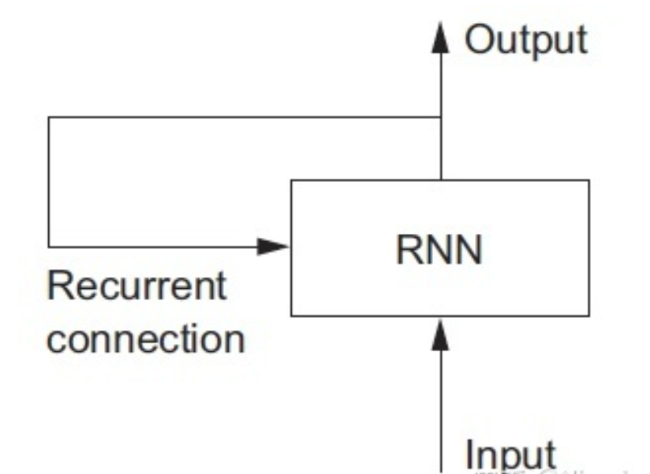
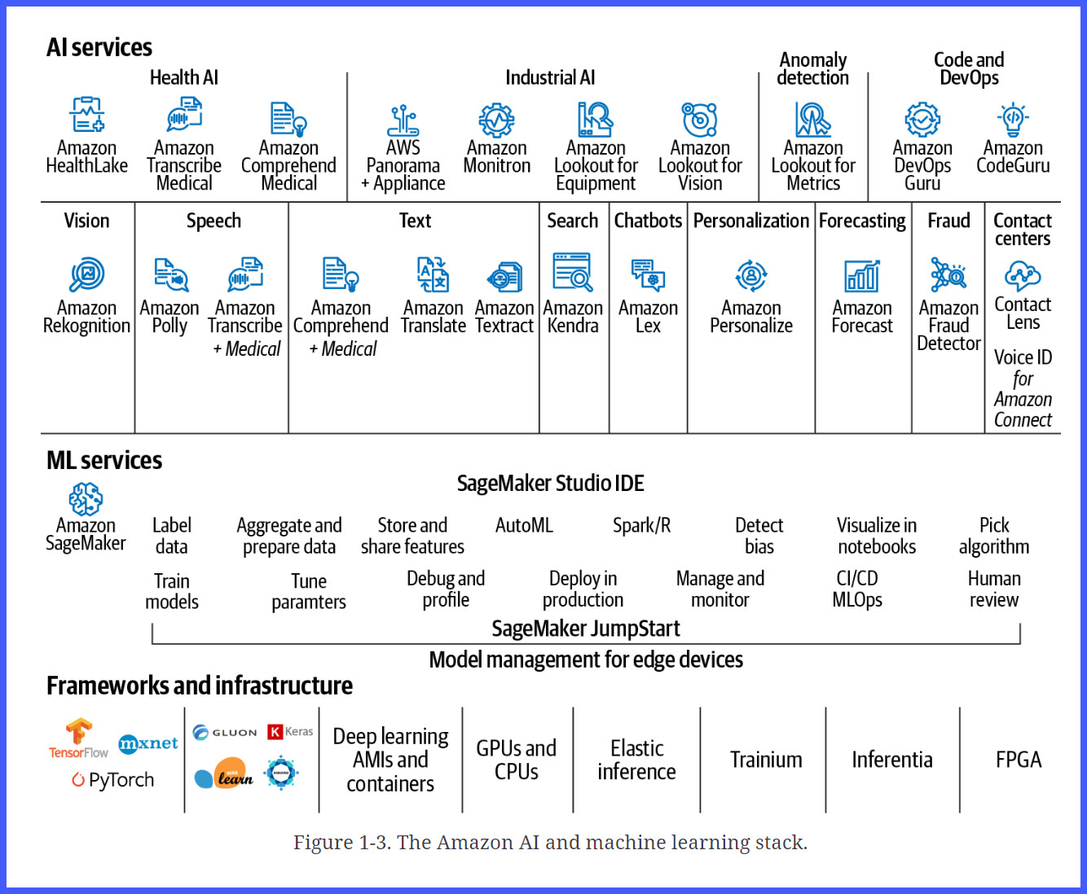
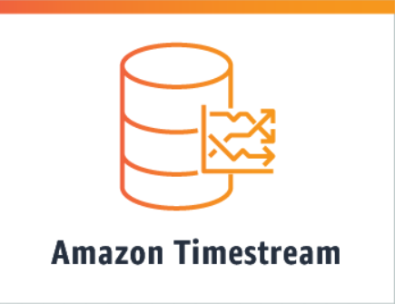
Research
2
Notes:
After researching, I found that AWS offers a lot of high-performance tools that can process real-time data and shorten machine learning cycles.
Some interesting RNN(Recurrent neural network) algorithms can help predict time-series data.
High, middle, and low levels show my targets. Showing I am a smart and quick learner.

Slide 4


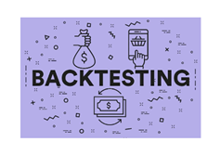
Develop a machine learning environment that can analyze stock data in real-time.
Target
3
Notes:
The system had 3 parts.
Storing Real-Time Stock Price Data in the AWS Cloud.
Training and deploying Machine Learning Models on SageMaker.
Using Python to run Mock Trading and perform Back-Testing.

Slide 5
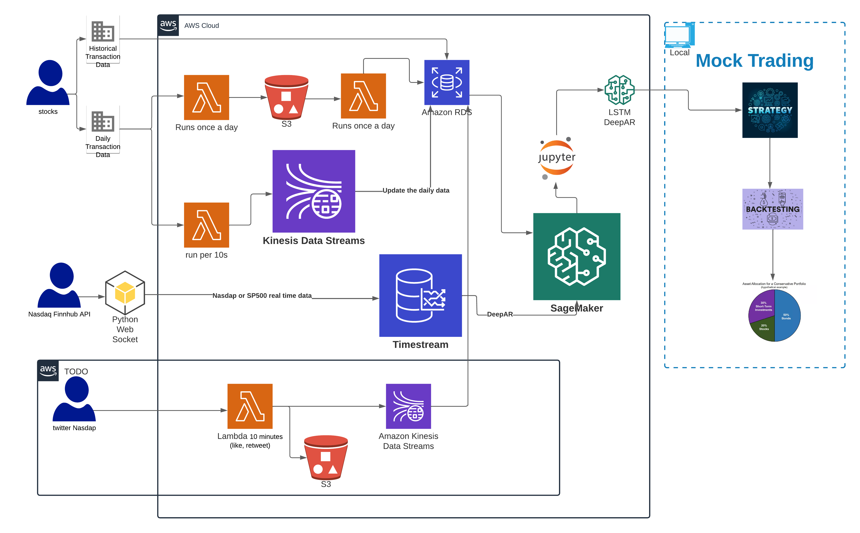
Architecture
4
Notes:
This architecture diagram showed that various data sources can be stored in suitable AWS services and databases. All machine learning run on Sagemaker. Finally, predictions were used by mock trading.
Real-time data was stored in TimeStream DataBase.
SageMaker speed up models traning time.
Kinesis helped me transfer data into RDS almost in real time.

Slide 6
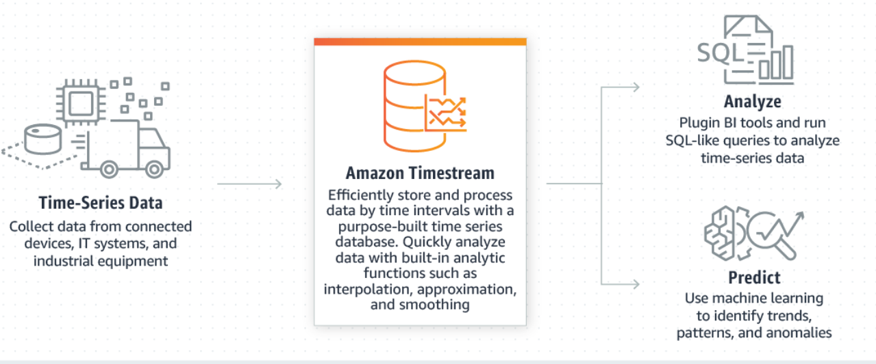
Timestream Database
Notes:
Real-time data can be stored in Timestream database. The database is easy to use.
Data can be accessed by SQL.

Slide 7
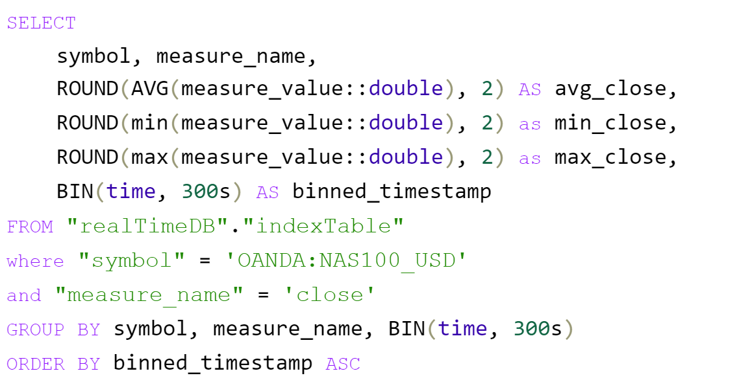
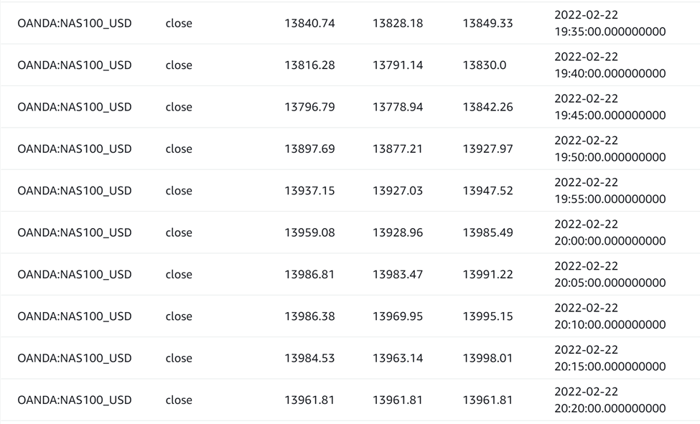
Timestream Database is easy to fetch data for different intervals.
Notes:
We can easily query different bin data by SQL. If we’d like to get interval of 5 minutes or 2 hours data, we only need to change the SQL a little bit,

Slide 8
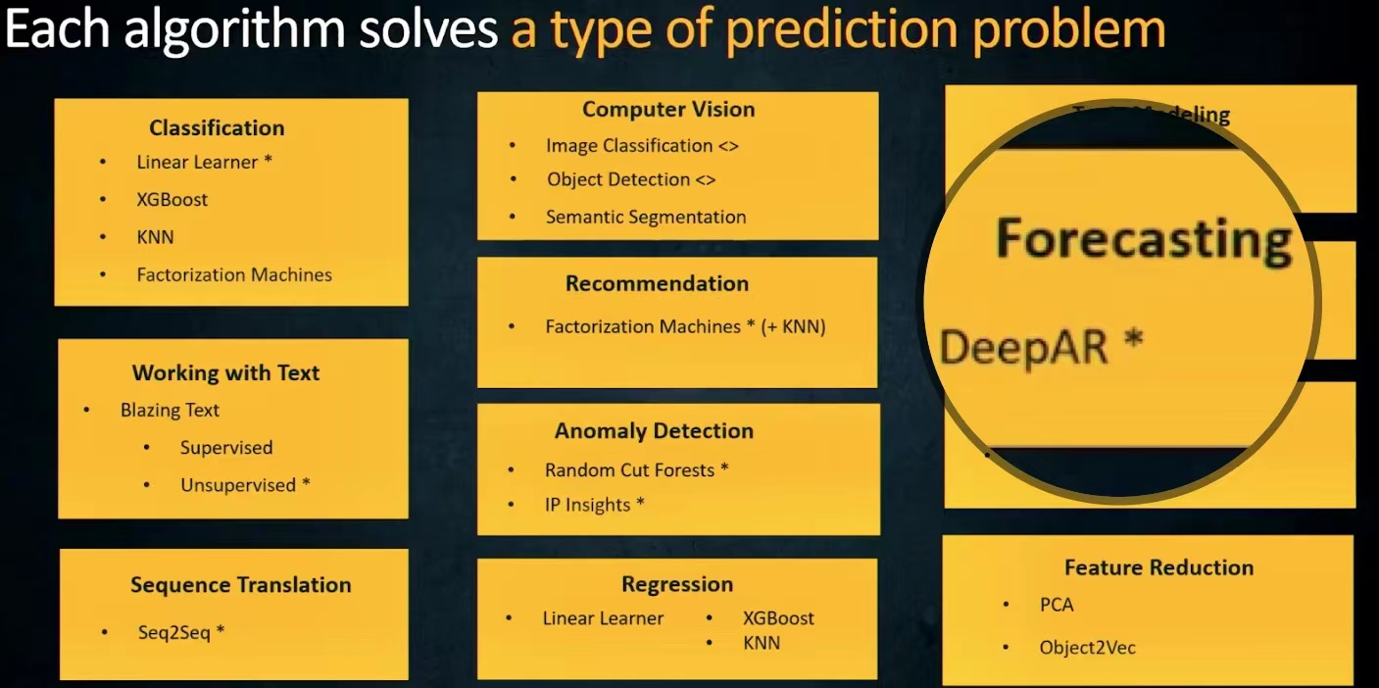
SageMaker
Notes:
SageMaker provides many algorithms to solve prediction problem.
The DeepAR algorithm can be used to forecast the time-series data.

Slide 9
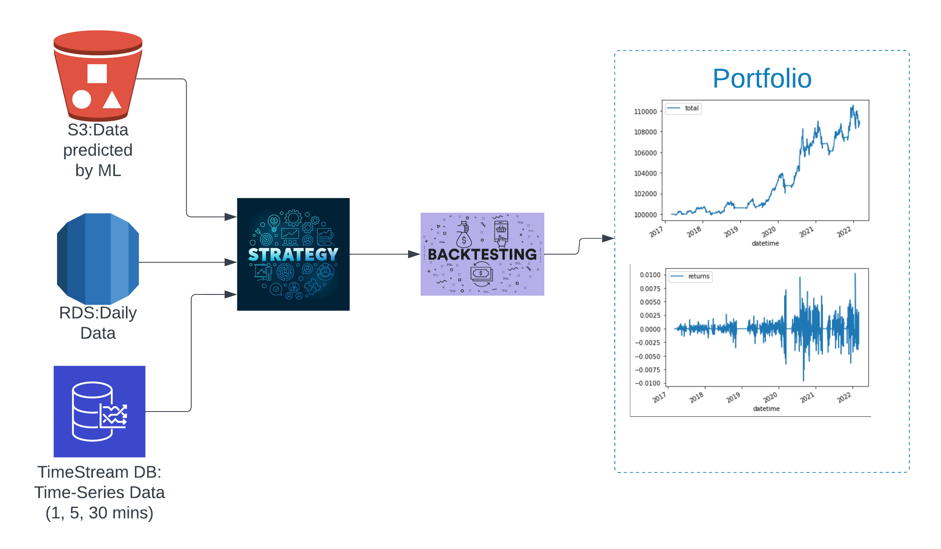
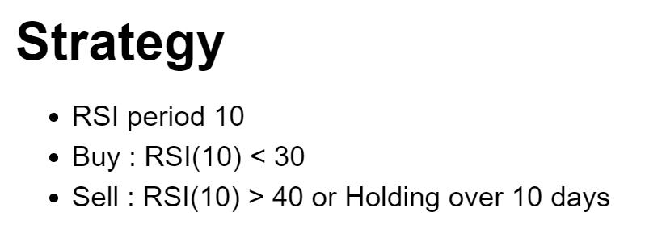
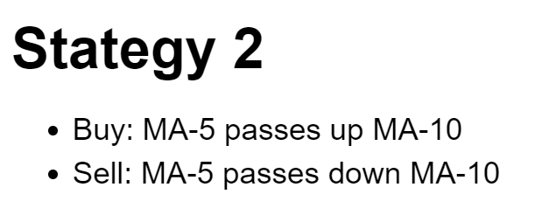
Mock Trading
8
Notes:
We can load data from different AWS services and databases into Mock Trading.
Then We can use trading strategies to evaluate models, whether models can make money or not, in order to help us make real trading decisions.

Slide 10
LSTM
Long Short-Term Memory recurrent neural networks
DeepAR
Probabilistic Forcasting recurrent neural networks
Models
5
Notes:
Two machine learning algorithms are used in the Capstone. They are
Long Short-Term Memory recurrent neural networks
Probabilistic forecasting with autoregressive recurrent neural networks

Slide 11
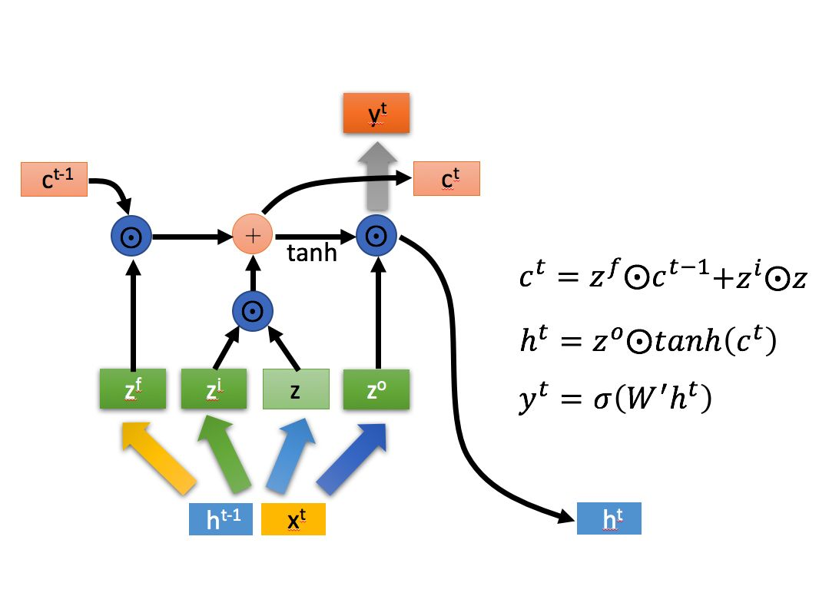
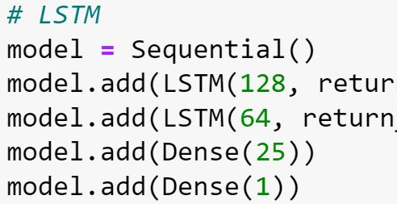
Long Short-Term Memory (LSTM)
Notes:
LSTM is better than simply RNN in long sequence data.
It solves the problems of gradient /ˈɡreɪdiənt/ disappearance and gradient explosion in training.
Although LSTM is difficult to understand, using Tensorflow we can quickly build an LSTM model with less than 10 lines of code.
It remembers things that need to be remembered for a long time through states and forgets unimportant information.

Slide 12
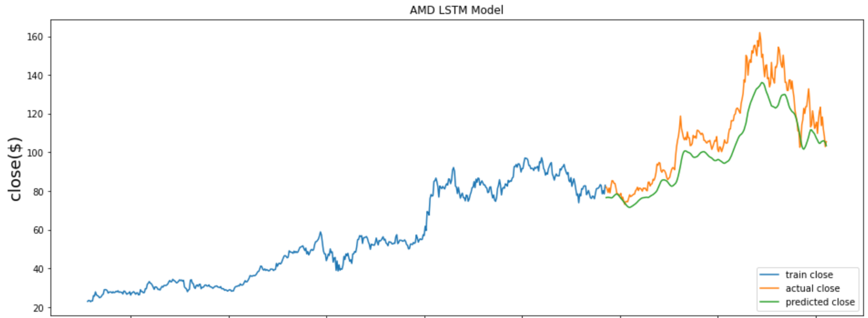
LSTM predict the prices of AMD
Notes:
The line-chart of LSTM shows, the predicted curve is similar to the real curve. But these forecastings showed delay.

Slide 13
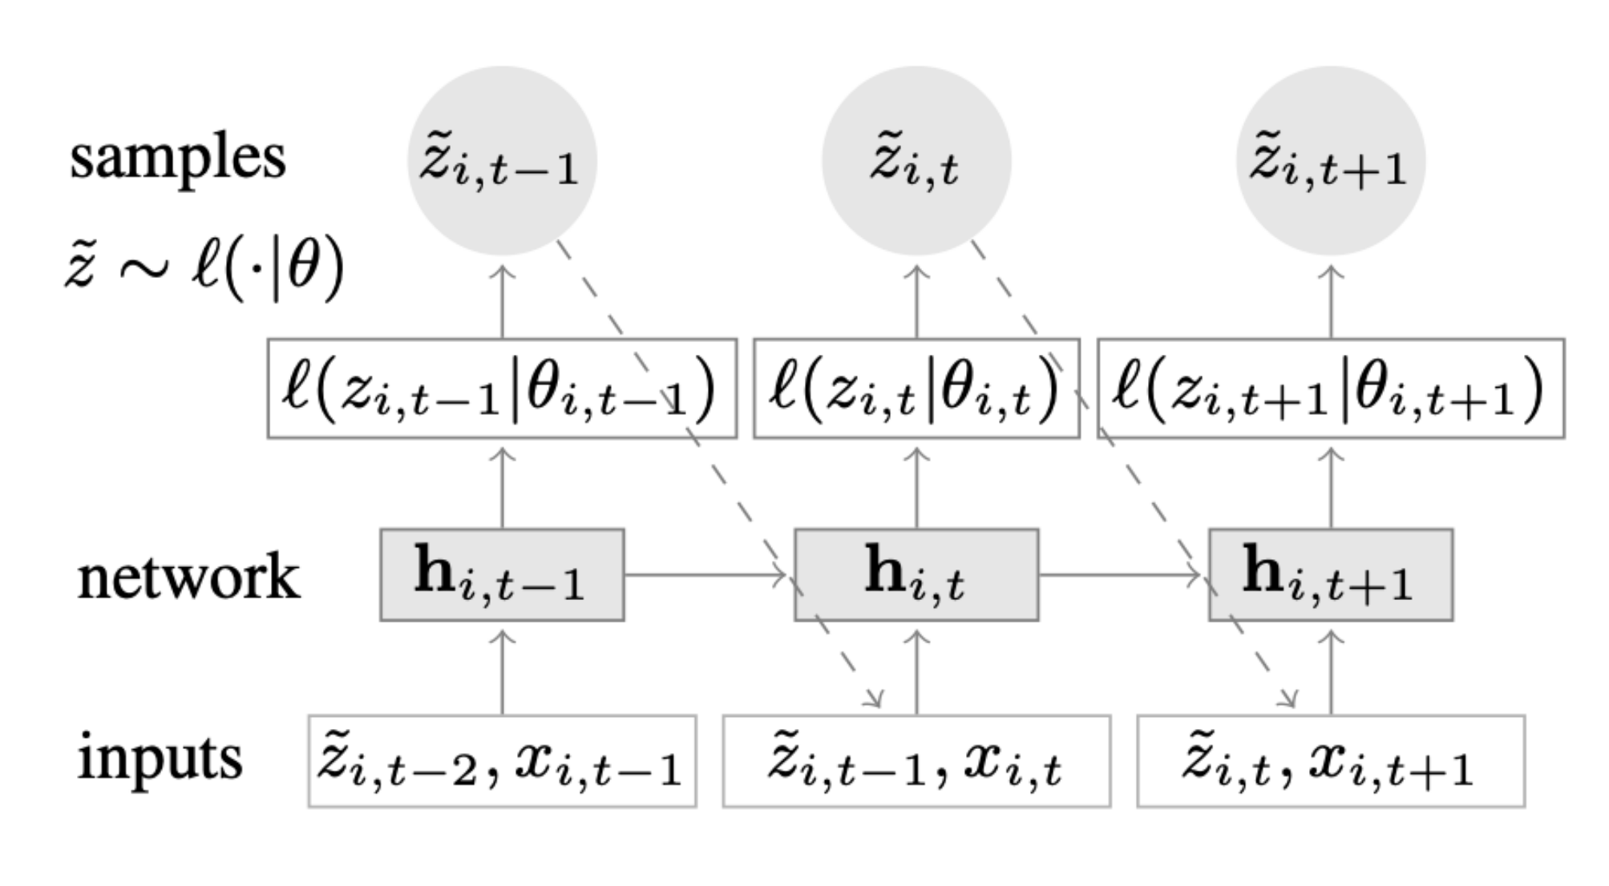
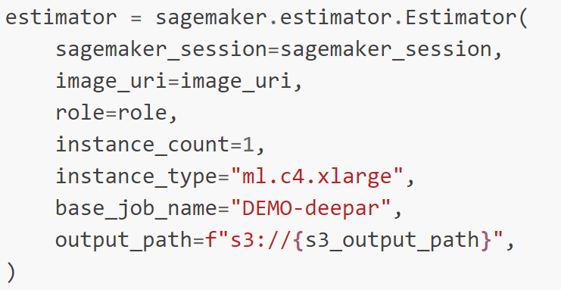
DeepAR
Notes:
DeepAR can produce probabilistic forecasts.
One DeepAR model supports Multiple Time-series data: For example, One model can predict 100 stocks. It will avoid a lot of repetitive work.
We can build a DeepAR very quickly on SageMaker.

Slide 14
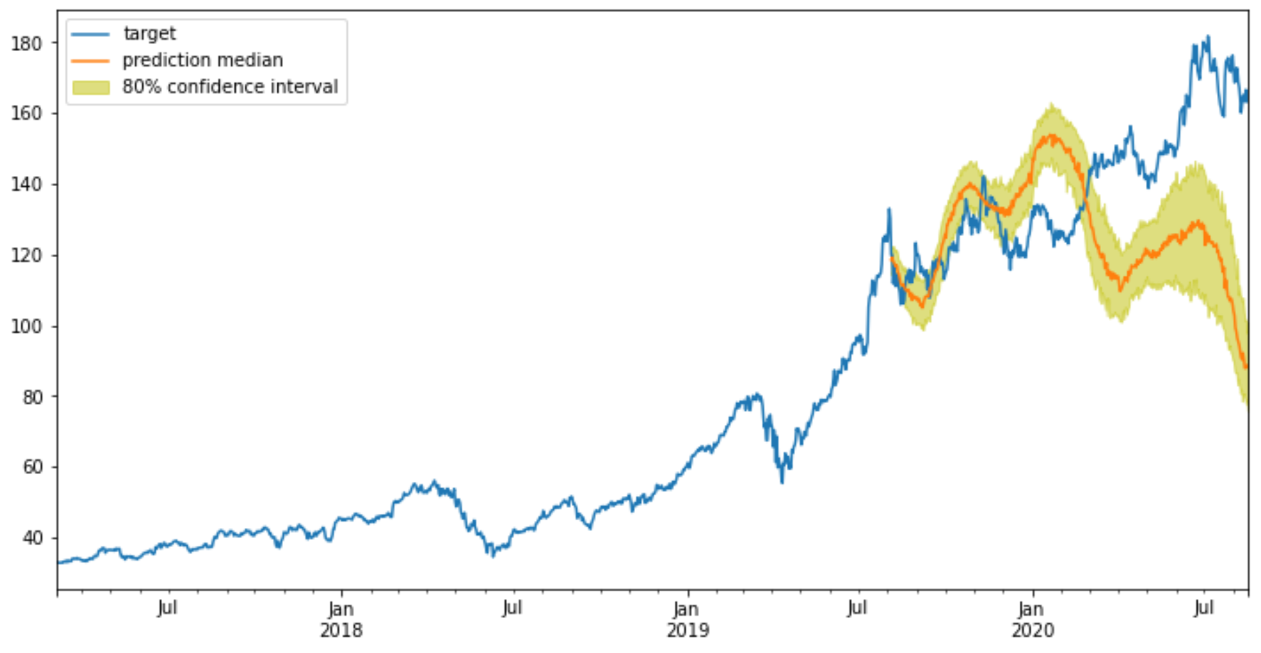
DeepAR predicted the 80% confidence interval of Apple
Notes:
The line-chart of DeepAR shows, the accuracy of early prediction is higher than the latter part of the prediction.

Slide 15
LSTM vs DeepAR
 | LSTM | DeepAR
Predicted Steps | Multi-steps | Multi-steps
Predicted results | Points | Probabilistic forecasts
Time series targets | One | Multiple
Notes:
There are main differences between 2 algorithms.
In many cases, the accuracy price of a stock is very difficult to predict.
DeepAR can predict the probability of a stock price. Probability is more useful than point prediction in real stock price predictions.

Slide 16
Analysis & Comparsion
6
Data
2 intervals: 1 day & 1 minute
10 indicators with different intervals
SMA, Bollinger Bands, etc [10, 20, 50, 100]
Models
3 LSTMs predict 1 step.
1 DeepAR predicts N steps.
Evaluation
RMSE
1 Trading Strategy: (The price goes up then buy).
Notes:
In data section:
I chose two types of intervals of data. 1 day and 1 minute.
I used 10 indicators. Like, Simple Moving Average, Bollinger Bands, etc. I hope they can improve the accuracy of models.
In model selection:
I compared 3 types of LSTM models and 1 DeepAR model.
root-mean-square error and a simply trading strategy were used to evaluate models.
If t-day’s is forecasted to rise, I will buy. Otherwise, I will sell.

Slide 17
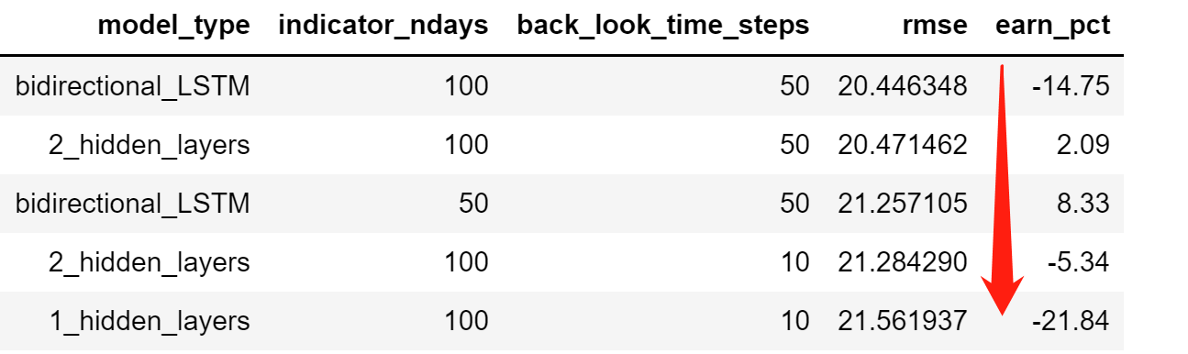
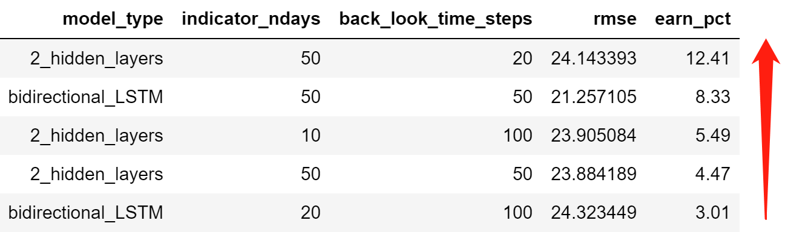
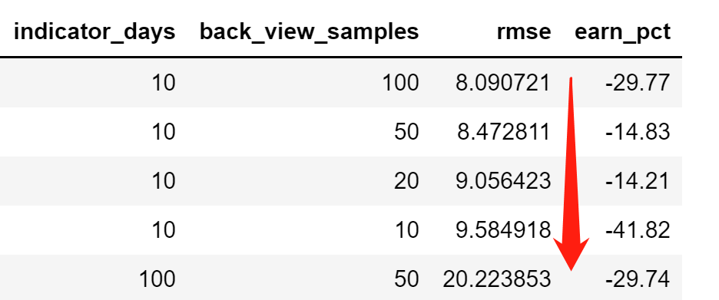
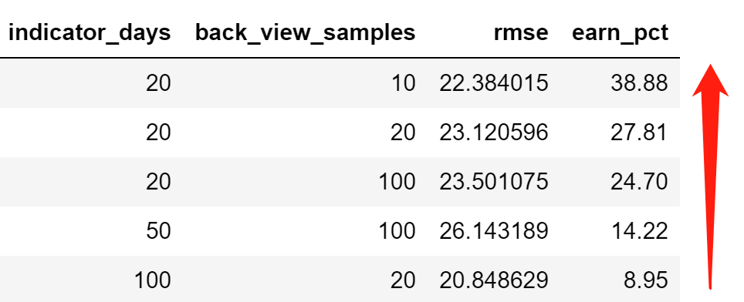
AMD interval 1-Day price (5 years) The change of 140 test points was -18.89% The price dropped from 107 to 90.
RMSE
% Earnings
LSTM
DeepAR
Notes:
This slide compared 4 types of models with intervals of 1-day.
I used 5 years of AMD data. The test set had 140 points. The change of test set was -18.89%
The first column showed that DeepAR had lower RMSE than LSTM had.
The second column showed that one DeepAR had the highest percentage of earnings in all models.
The Top Left table showed that LSTM models with larger intervals of indicator could get lower RMSE.
But the bottom left table showed that DeepAR models with intervals of 10 days got lower RMSE than LSTM models.
The bottom right table showed one of DeepAR got the highest percentage of earnings.

Slide 18
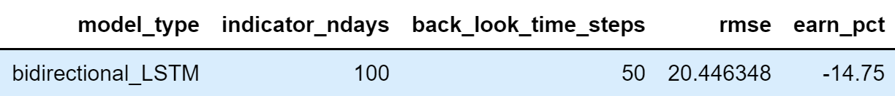
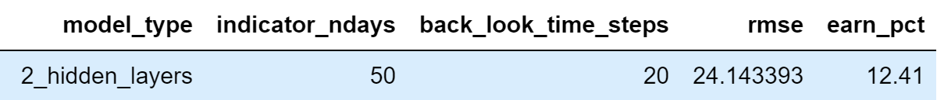
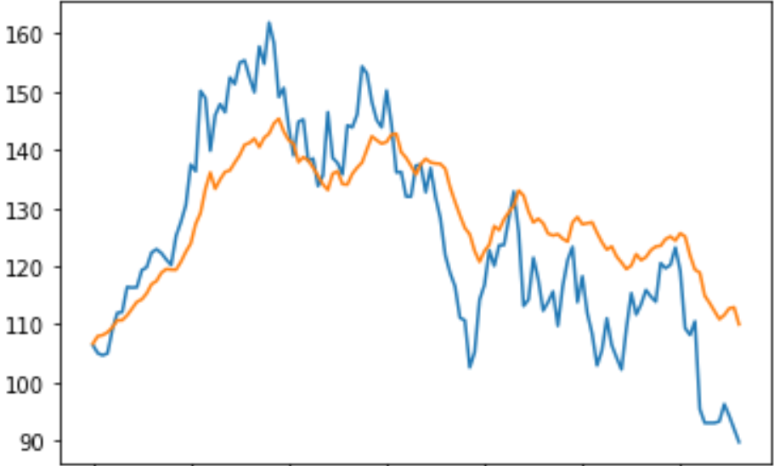
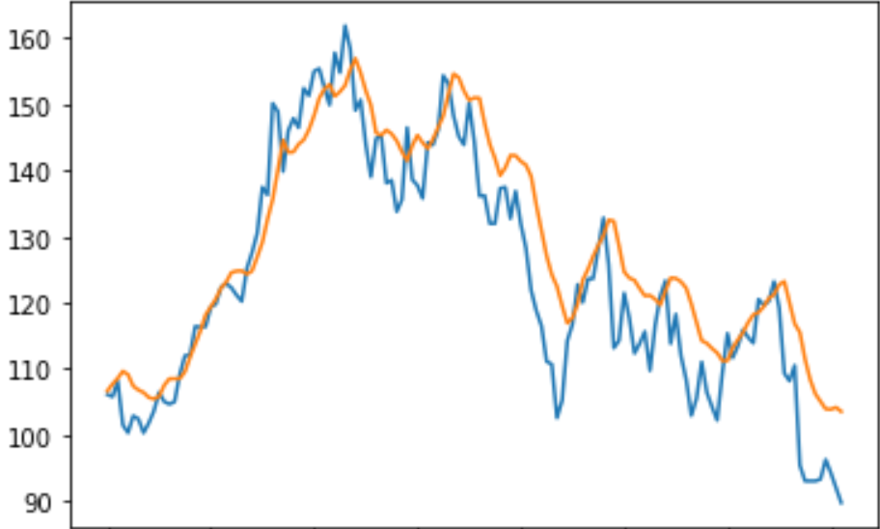
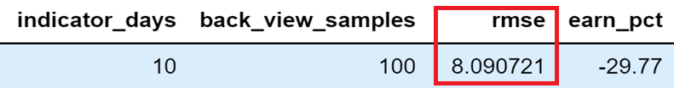
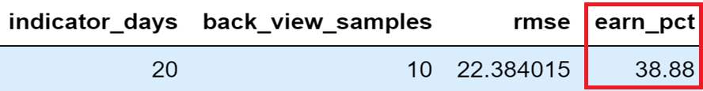
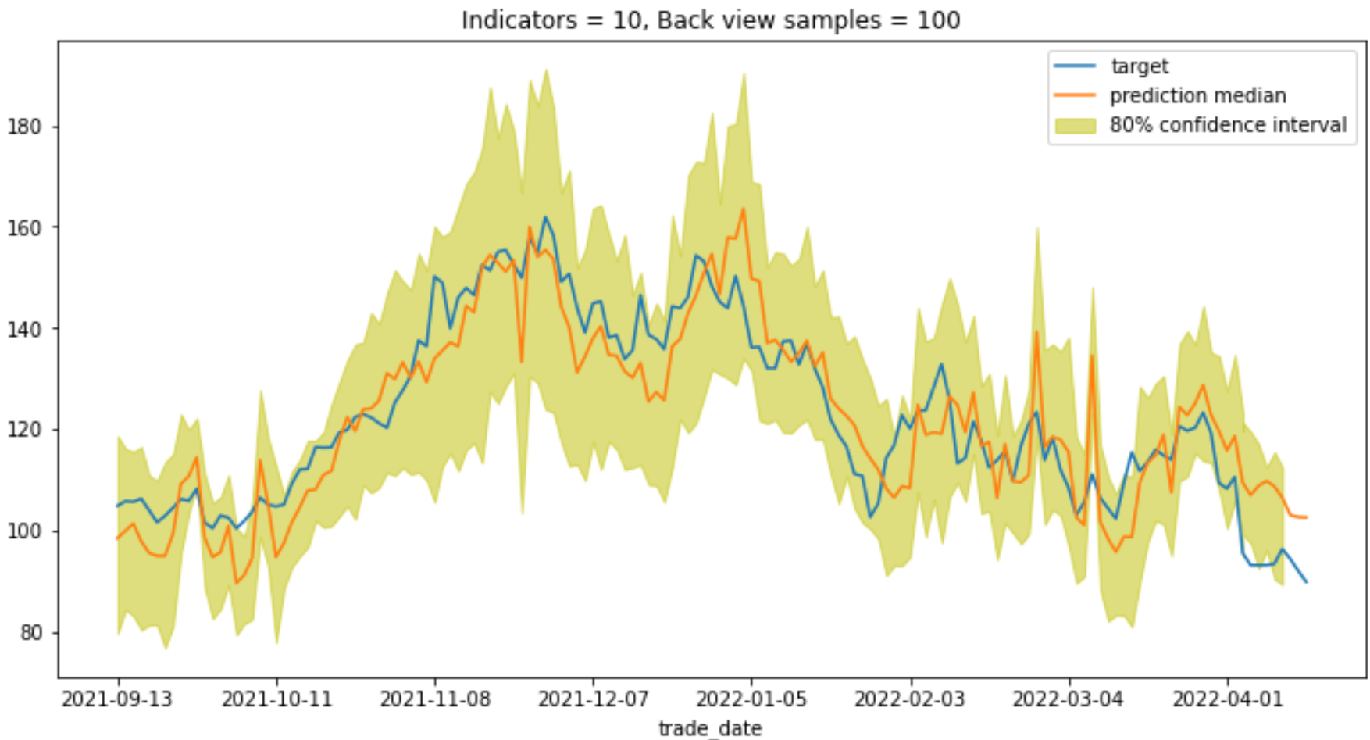
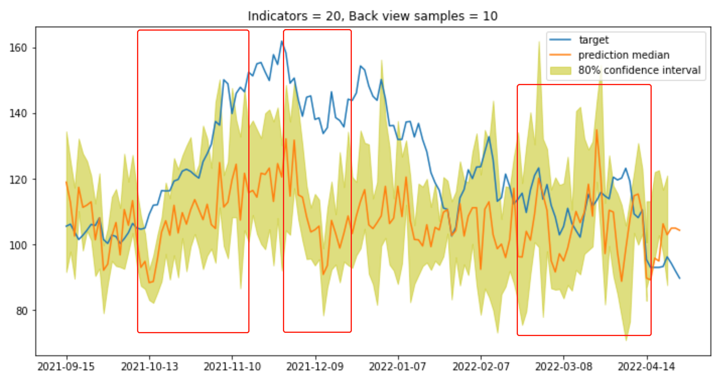
AMD interval 1 Day price (5 years) The change of 140 test points was -18.89% The price dropped from 107 to 90.
% Earnings
RMSE
LSTM
DeepAR
Notes:
The bottom left DeepAR model got the lowest RMSE with 8.09. But it had -29.77% of earnings.
The bottom right DeepAR model had the highest percentage of earnings with near 39%. It was higher than the actual price change.
Why the model had the highest percentage of earnings? The reason may be that the predictions followed same trends as the real data at certain periods. It was probably just a coincidence. Or if we use another strategy, the model might not earn so much.
All real data is in the 80% confidence interval.

Slide 19
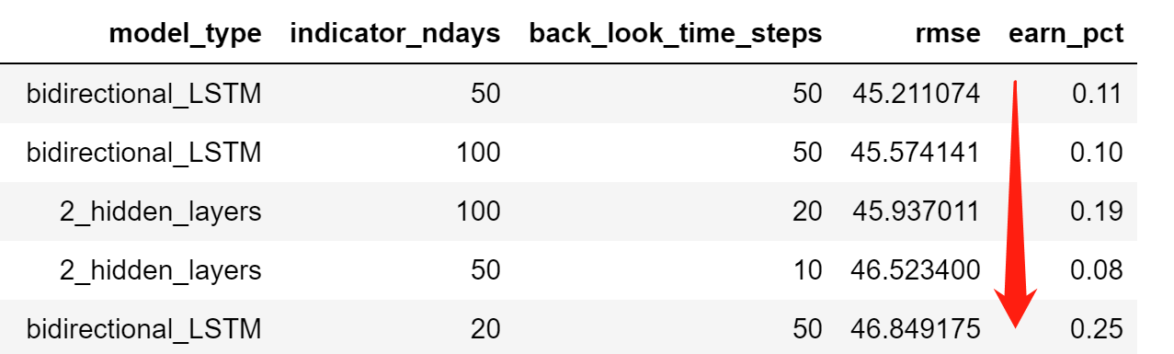
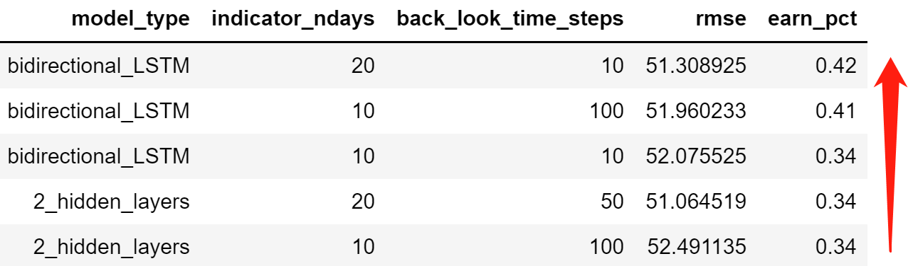
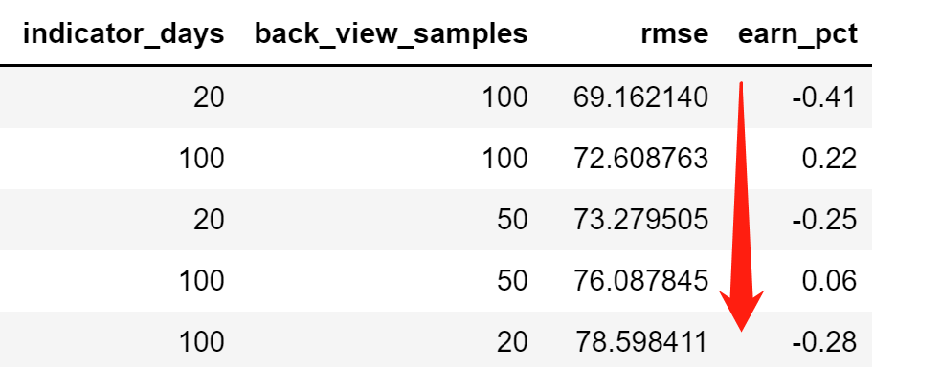
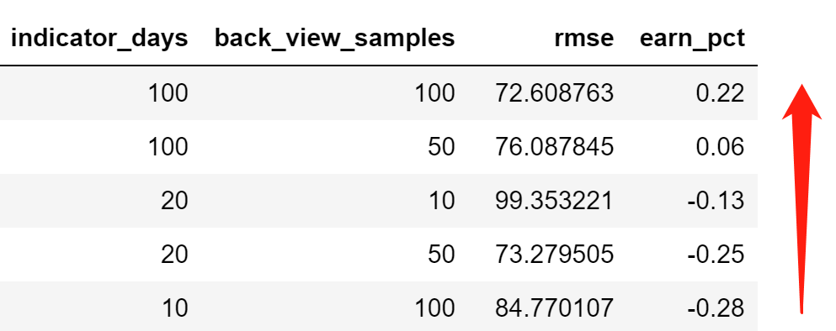
Nasdaq interval 1 minute price on 04/22 The change of 130 test points was 0.4% The value rose from 13422 to 13358
RMSE
% Earnings
LSTM
DeepAR
Notes:
This slide compared 4 types of models with intervals of 1-minute.
I used the data of Nasdaq on the April 22. Test set had 130 points. The change of test set is 0.4%
The first column showed that LSTM models had lower RMSE than DeepAR models had.
The second column showed that LSTM modes got higher percentage of earnings than DeepAR models got. One of LSTM model had the highest percentage of earnings in all.

Slide 20
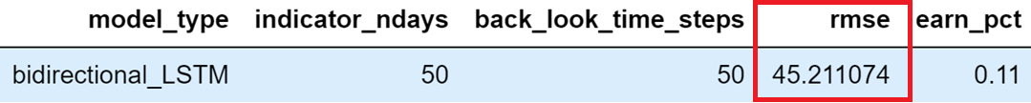
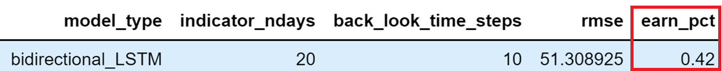
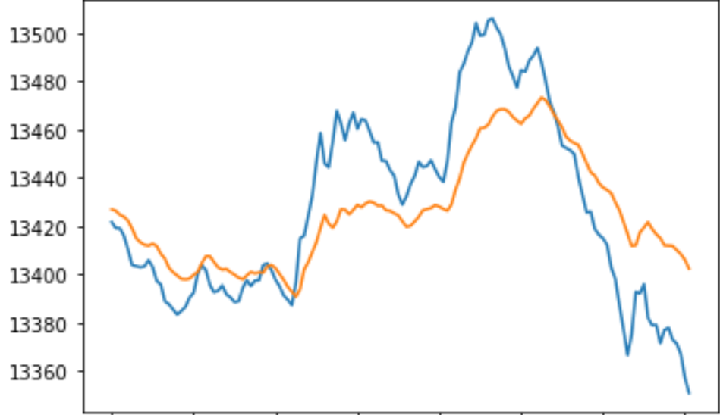
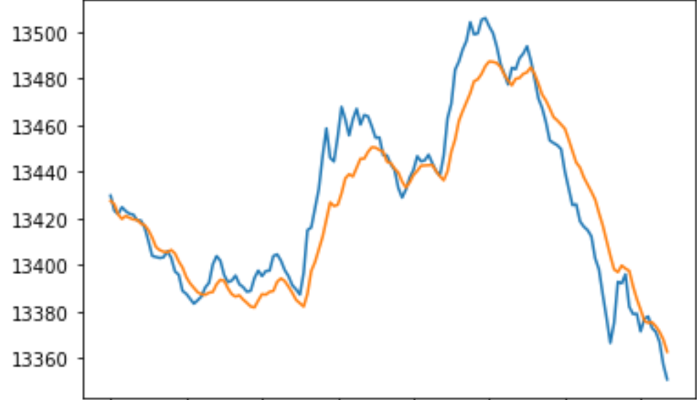
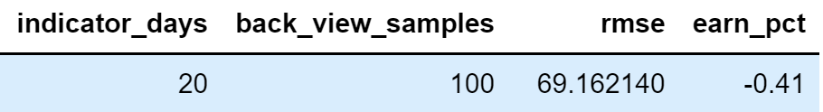
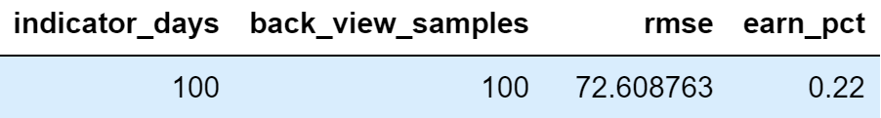
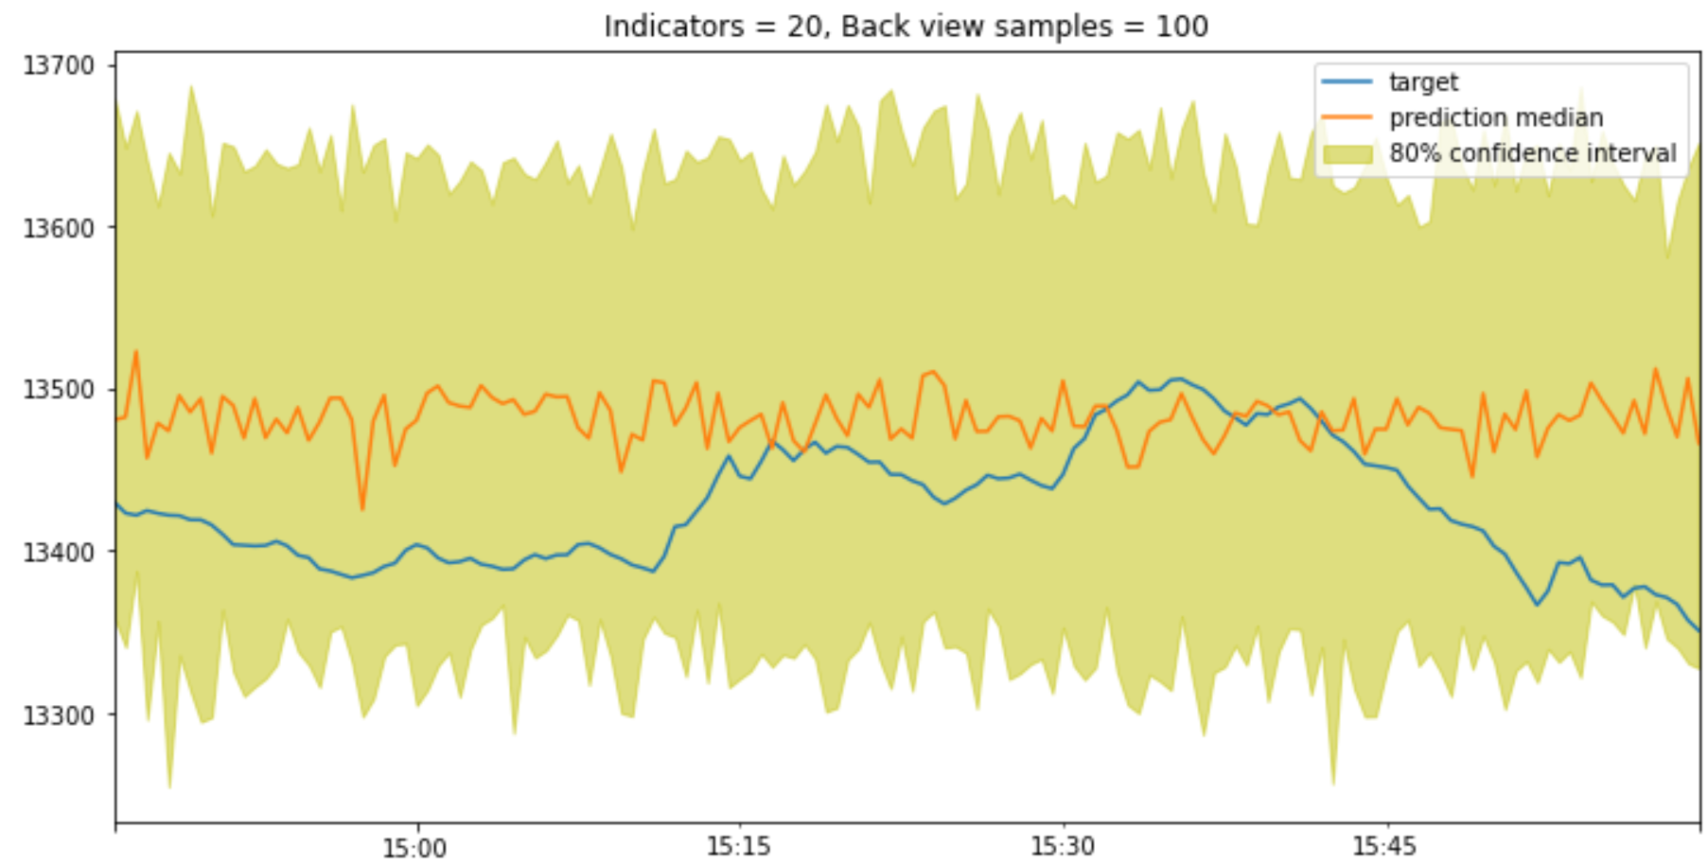
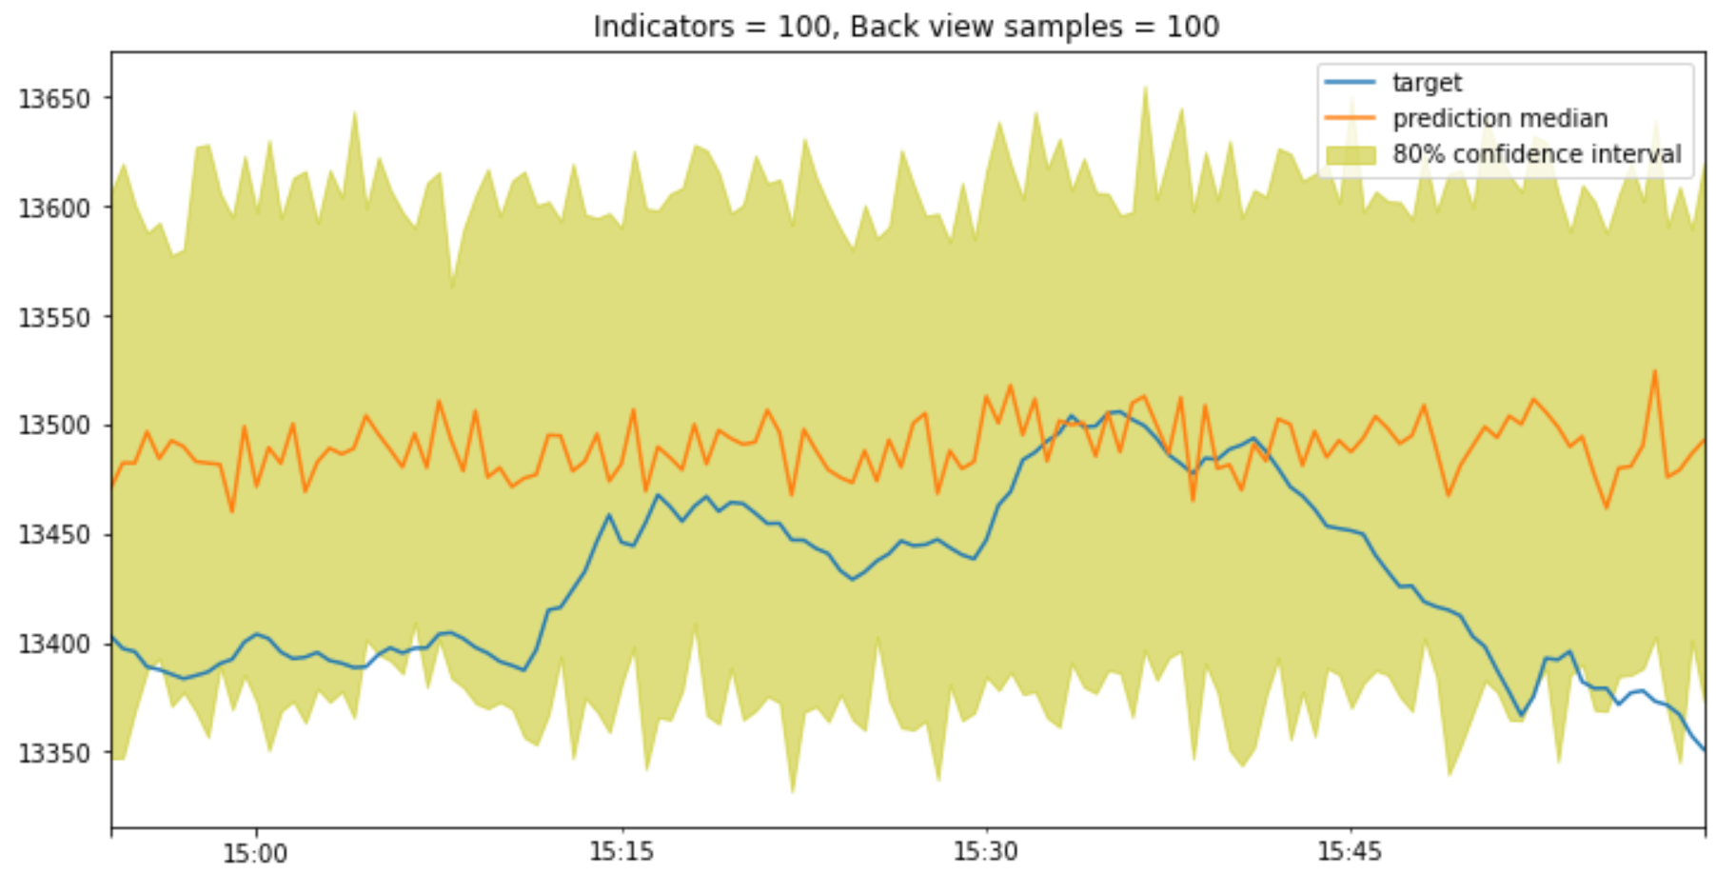
Nasdaq interval 1 minute price on 04/22 The change of 130 test points was 0.4% The value rose from 13422 to 13358
% Earnings
RMSE
LSTM
DeepAR
Notes:
The top left LSTM model got the lowest RMSE with around 45. But it did not have the highest percentage of earnings.
The top right LSTM model had the highest percentage of earnings with 0.42%. It was higher than the change in real data.
The bottom 2 DeepARs did not predict trends similar to the real data. Why did they show random trends? The reason might that there was no significant change between minutes.

Slide 21
The LSTM and DeepAR are able to predict the prices of stocks. DeepAR is better than LSTM on intervals of 1 Day. Two techniques are not good at forecasting prices with small changes, like intervals of 1-minute.
Summary of models
7

Slide 22
Compared to my previous job
8
Save 70% time.
 | Previous | Capstone
Technology | Relationship DB, Non-SQL DB, BigData tools, etc | AWS tools Timestream, Kinesis, SageMaker
Time cost | 2 months | 3 months
Team members | 5 | 1
Trading decisions | Trading strategies | Data Analysis, ML, Strategies
Notes:
In my previous job, I built a system that was similar to this Capston.
The capstone is easier, more scientific, and saves more time.

Slide 23
1）Effort and time. 2）The problems of LSTM and DeepAR. Diffcult to understand & Time consuming. 3）How to evaluate predictions of prices of stock. Can RMSE & R^2 still work?
Challenge
9
Notes:
1) I spent a lot of effort and time building the real-time analysis system. But I enjoyed this process because I taught myself many AWS tools and algorithms. They can predict prices of stock.
2) The 2 algorithms are not easy to understand. They both have a lot of hyper-parameters to test.
If we want to get a good model, we have to spend a lot of computing time.
3) A model might have a good evaluation value, but it could not make money.

Slide 24
Improve the accuracy of models 1) More Data
2) More Features
3) NLP
Next Steps
10
Notes:
1) I will add historical financial reports for stocks as categories. Also use more indictors as numerical features.
2) NLP is a powerful tool. It can provide more useful information for models.
Use NLP to analyze news and articles,
If a stock rises after an article is published, the article will be marked as positive.
When we get 100 articles, we can use NLP to get keywords that could be used to predict new articles.

Slide 25
Q & A Thank you
Notes:
Thank you again for coming to my presentation.

